Slide 1
Understanding individual human mobility patterns Written by Marta C. Gonzalez, Cesar A. Hidalgo, and Albert-Laszlo Barabasi
Neha deshpande

Slide 2
Overview
Previous Work
Motivation
Network Model
Datasets
Methods and Results
Displacement Distribution
Radius of Gyration
Shape of Individual Trajectories
Experiment
Datasets
Methods
Results
Future Work
Notes:
(These don’t have designer IDs since they were based off the default master slides already in the deck.

Slide 3
Previous Work
Bank Notes
Animals
Keep track of bank note sightings
500,000 bank notes
Fat-tailed (skewed) displacement
Levy flight distribution, β = 1.59
Population mobility, not individual movement
Albatrosses
Monkeys
Marine predators
Levy flight distribution, β < 2
Notes:
(These don’t have designer IDs since they were based off the default master slides already in the deck.

Slide 4
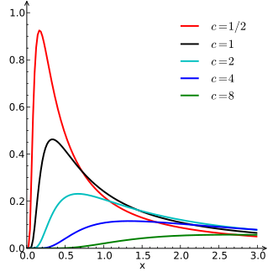
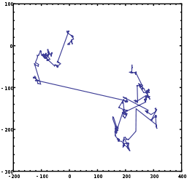
Levy Flight
Levy Distribution
Levy Flight
High probability of low step size
Low probability of high step size
Random walk, step size follows Levy distribution
(Turning angle is uniformly distributed)
Notes:
(These don’t have designer IDs since they were based off the default master slides already in the deck.

Slide 5
Motivation
What was the study?
How is this helpful?
Understanding individual human travel patterns
Intra-day
Daily
Long term
Where do people go?
Where do they spend their time?
How often did people visit different places?
Planning city layouts
Predicting traffic
Emergency response
Preventing the spread of diseases
Biological infections
Electronic viruses
Power/telephone line locations
Notes:
(These don’t have designer IDs since they were based off the default master slides already in the deck.

Slide 6
Datasets
$$D_{1}$$
$$D_{2}$$
10,000 randomly-selected individuals
6 months
User’s cell tower location during a call/text
16,264,308 displacements
Used for conducting the study
206 individuals
2 weeks
User’s cell tower every 2 hours
10,407 displacements
Used to ensure $D_{1}$ wasn’t biased
Notes:
Location of the cell tower that the user’s phone was connected to during a phone call/text
First dataset was for the actual study
Second dataset was to ensure that the first dataset wasn’t biased

Slide 7
Network Model
Modeled as a network
Each cell tower is a node
Movement between locations is an edge
Displacement (edge): movement from one location (node) to another
Most people moved within a small area, few people moved hundreds of kilometers
Notes:
Circle is radius of gyration – where they spent most of their time

Slide 8
Distribution of Displacements
“Displacement” = edge length
Truncated power-law shown below
Truncated = power-law multiplied by an exponential function
Exponential function stabilizes tail skew to compensate for lack of data
β = 1.75 ± 0.15 (mean ± standard deviation)
Similar to bank note dispersal
Δ$r_{0}$ = 1.5 km
K for $D_{1}$= 400km, K for $D_{2}$= 80km
Notes:
Location of the cell tower that the user’s phone was connected to during a phone call/text
First dataset was for the actual study
Second dataset was to ensure that the first dataset wasn’t biased

Slide 9
Radius of Gyration
Characteristic distance travelled by a user within a certain period of time
Distribution of radius of gyration for all users
Model = truncated power-law
Other possibilities: random walk, Levy flight, truncated Levy flight
β = 1.65 ± 0.15 (mean ± standard deviation)
$r_{g}^{0}$ = 1.5 km
K = 350 km
Notes:
Location of the cell tower that the user’s phone was connected to during a phone call/text
First dataset was for the actual study
Second dataset was to ensure that the first dataset wasn’t biased

Slide 10
Individual Trajectories
Should the radius of gyration increase with time?
People are more likely to visit places they have not been to before
Individuals split into
small ($r_{g}$< 3 km)
medium (20 < $r_{g}$< 30 km)
large ($r_{g}>$100 km)
Best fit model: logarithmic
Also modeled random walk and Levy flight
Notes:
Location of the cell tower that the user’s phone was connected to during a phone call/text
First dataset was for the actual study
Second dataset was to ensure that the first dataset wasn’t biased

Slide 11
Location Frequency Peaks
Probability that a user returns to the same location repeatedly
Low probability of going somewhere new
Peak every 24 hours (i.e. at home)
Solid line is probability of returning to the same location with a random walk model
Notes:
Location of the cell tower that the user’s phone was connected to during a phone call/text
First dataset was for the actual study
Second dataset was to ensure that the first dataset wasn’t biased

Slide 12
Location Frequency Model
Probability of returning to the same location regardless of time
P(L) = 1/L, with L being the rank of the location
Rank 1: where they spend most time
High probability of returning to somewhere they spend a lot of time
Low probability of returning to a place they don’t spend a lot of time
Logarithmic
Axes are logarithmic, so model looks like a straight line
Notes:
Location of the cell tower that the user’s phone was connected to during a phone call/text
First dataset was for the actual study
Second dataset was to ensure that the first dataset wasn’t biased

Slide 13
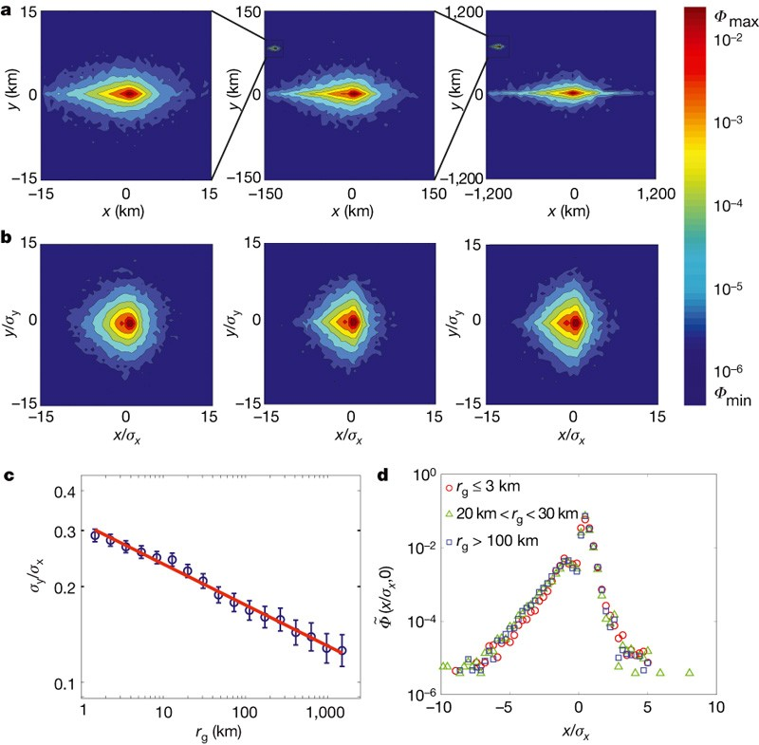
Shape of Human Trajectories
What is the probability of a user being at a specific (x,y) position?
Probability density function
“spatial anisotropy” (density is not circular)
anisotropy ratio S ≡ σy/σx
σ is standard deviation
How “circular” is the data?
Rescaled distribution using standard deviation
Notes:
An-iso-tropy

Slide 14
Shape of Human Trajectories
S ratio decreases with $r_{g}$
S = σy/σx = $r_{g}^{−\text{η}}$ where η = 0.12
η is small
Not enough (or biased) data?
Is this really a good model?
Other models might be better
Notes:
Location of the cell tower that the user’s phone was connected to during a phone call/text
First dataset was for the actual study
Second dataset was to ensure that the first dataset wasn’t biased

Slide 15
Evaluation
Results are consistent with intuition
Most likely to spend time at home, work, or school
Less likely to go shopping
Even less likely to go on vacation
More likely to visit places they have been to before
Data collection might be biased
Inconsistent proximity of cell towers
More cell towers = more displacements
Someone in a city could move the same amount as someone in a rural area, but register more displacements
Notes:
Location of the cell tower that the user’s phone was connected to during a phone call/text
First dataset was for the actual study
Second dataset was to ensure that the first dataset wasn’t biased

Slide 16
Experiment
How does precipitation affect human mobility?
Hypothesis: On rainy days,
People will not go outside
People will stay at home
People will be less likely to go shopping
The same probability of going to work and school
Notes:
Location of the cell tower that the user’s phone was connected to during a phone call/text
First dataset was for the actual study
Second dataset was to ensure that the first dataset wasn’t biased

Slide 17
Google Mobility Dataset
https://www.google.com/covid19/mobility/
Breaks up into countries, states, and counties – Rensselaer County
Splits up into different categories: Grocery & pharmacy, Parks, Transit stations, Retail & recreation, Residential, Workplaces
Measured in percent change from baseline for that day of the week
Baseline was in 5 weeks of 2020 before the quarantine officially started: Jan 3 - Feb 6
country_region_code | country_region | sub_region_1 | sub_region_2 | date | retail_and_recreation_percent_change_from_baseline
US | United States | New York | Rensselaer County | 2/15/2020 | 5
Notes:
Useless columns like location ID

Slide 18
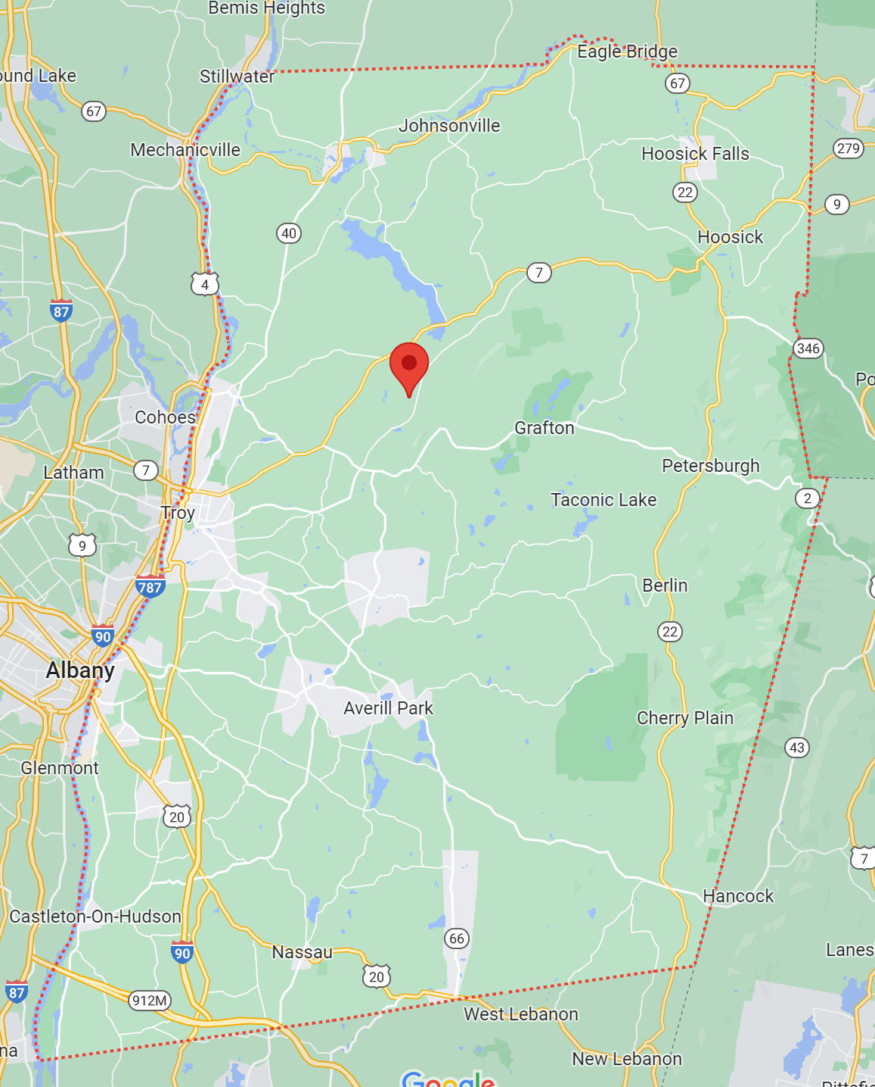
Weather Dataset
https://www.ncdc.noaa.gov/cdo-web/datasets/GHCND/stations/GHCND:US1NYRN0013/detail
National Oceanic and Atmospheric Administration (NOAA) keeps track of weather based on the weather station
Troy 6.9 NE
Latitude, longitude, elevation, etc.
Inches of precipitation
STATION | NAME | LATITUDE | LONGITUDE | DATE | PRCP
US1NYRN0013 | TROY 6.9 NE, NY US | 42.79035 | -73.56226 | 1/4/2020 | 0.06
Notes:
Location of the cell tower that the user’s phone was connected to during a phone call/text
First dataset was for the actual study
Second dataset was to ensure that the first dataset wasn’t biased

Slide 19
Data Preprocessing and Experiment Plan
Google Mobility dataset
Keep only the date and percent changes columns
Keep only rows where data was collected in Rensselaer County in 2020
Weather dataset:
Keep only date and inches of precipitation
Inner join the two datasets on the date (pandas DataFrame)
Inner join removes “baseline” dates
Split up into two subsets
Inches of precipitation == 0
Inches of precipitation != 0
Graph the two subsets in a bar graph (Matplotlib)
Notes:
Location of the cell tower that the user’s phone was connected to during a phone call/text
First dataset was for the actual study
Second dataset was to ensure that the first dataset wasn’t biased

Slide 20
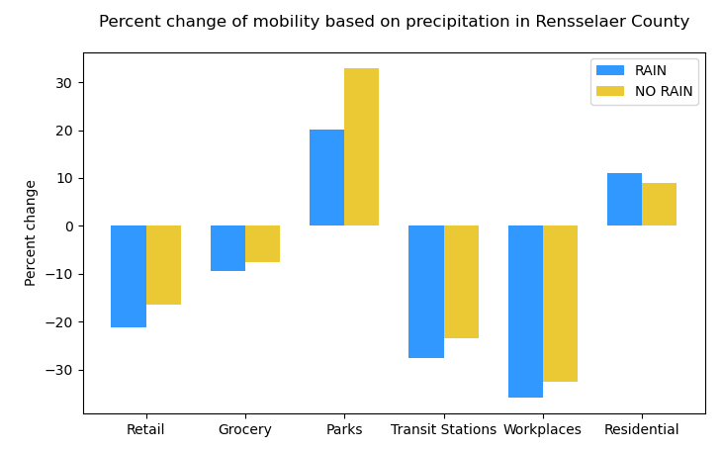
Experiment Result
Percent change is consistently lower during rain for all categories except Residential
Significant difference for Parks
Not much difference in Grocery, which is essential
Unexpected: lower during rain for transit stations
Public transit is better than walking in the rain?
Prefer to drive themselves?
Data is during quarantine – option to work from home
How would this be different in non-quarantine times?
Notes:
Location of the cell tower that the user’s phone was connected to during a phone call/text
First dataset was for the actual study
Second dataset was to ensure that the first dataset wasn’t biased

Slide 21
Future Work
Phone’s GPS location (latitude, longitude) instead of cell tower
Work on modeling individual human trajectory shape
Probability distribution of location
Compare human mobility in pre-quarantine, quarantine, and post-quarantine times
Google Mobility dataset doesn’t have anything before Feb 2020 or after October 2022
How will these results impact the real world?
Make existing cities more efficient
Planning new cities
Notes:
Location of the cell tower that the user’s phone was connected to during a phone call/text
First dataset was for the actual study
Second dataset was to ensure that the first dataset wasn’t biased

Slide 22
Works cited
Paper: https://www.nature.com/articles/nature06958
Image: https://en.wikipedia.org/wiki/L%C3%A9vy_distribution
Image: https://en.wikipedia.org/wiki/L%C3%A9vy_flight
https://stats.stackexchange.com/questions/208883/what-exactly-is-a-truncated-power-law-distribution
Google Mobility dataset: Google LLC "Google COVID-19 Community Mobility Reports". https://www.google.com/covid19/mobility/ Accessed: Nov 8 2022.
Precipitation dataset https://www.ncdc.noaa.gov/cdo-web/datasets/GHCND/stations/GHCND:US1NYRN0013/detail
Rensselaer County map: https://maps.google.com/
Notes:
Location of the cell tower that the user’s phone was connected to during a phone call/text
First dataset was for the actual study
Second dataset was to ensure that the first dataset wasn’t biased

